Slide 1
Harmony in Myself
Unit 2

Slide 2
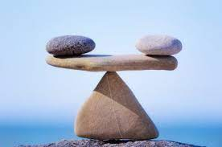
Harmony in Self
The term harmony means compatibility in opinion and action.

Slide 3
Human Being
  Human Being = I (self) + Body
  Human Being as Coexistence of Self(‘I’) & ‘Body’
Human being is a combination of sentient (‘I’) which relates to all the feelings, and material ‘Body’ which refers to all Physical facilities available to us.
There is an exchange of information between the two. Our body acts according to the instruction given by our “Jivan”

Slide 4
Human Being as Coexistence of Self(‘I’) & ‘Body’
Coexistence with
Human
I (Self)
Body
Information

Slide 5
Need of Self (‘I’) & ‘Body’
 | I (Self) | (Body)
Need are | Happiness (Sukh), Trust, Respect … | Physical Facilities (Suvidha), Food, Clothing…
In Time, needs are… | Continuous | Temporary
In Quantitiy, needs are …. | Qualitative | Quantitative
Needs are fulfilled by …. | Right Understanding & Right Feelings | Food, Clothing, etc…..
Activities are .. | Knowing, Assuming, Recognizing, Fulfilling (Desiring, Thinking…) | Recognizing, Fulfilling, (Breathing, Heartbeat …)
It is of Type …. | Conscious (Non-material) | Physico-Chemical (Material)

Slide 6
Needs of Self (‘I’) & ‘Body’
The basic need of I is living in the state of Happiness (Sukha), and
The basis needs of body are Physical Facilities (Suvidha) like food for nourishment, clothes for protection, house for shelter

Slide 7
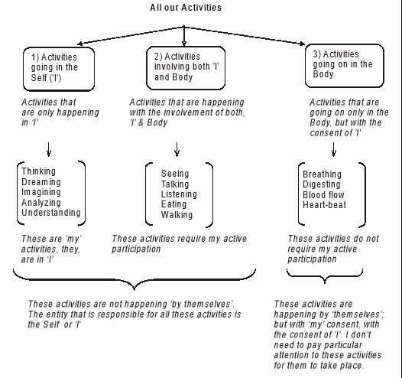
Understanding activities in the self & activities in the body

Slide 8
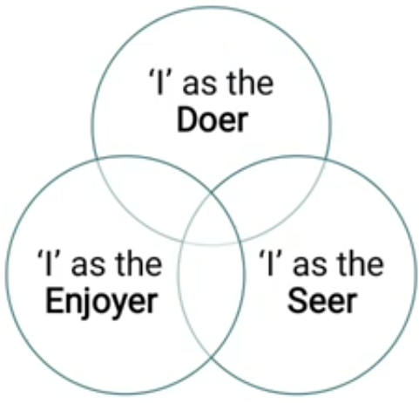
Understanding the Body as an Instrument of ‘I’ (I being the doer, seer and enjoyer)

Slide 9
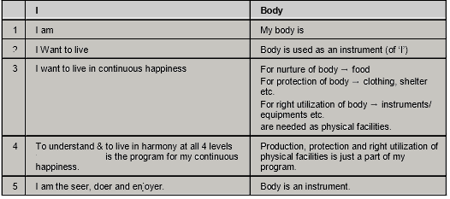
Understanding the Body as an Instrument of ‘I’ (I being the doer, seer and enjoyer)
The understanding , feeling, need, capacity and utility of ‘I’ and ‘body’ are different which can be understood from the following table.

Slide 10
Understanding
‘I’ am (‘I’ knows it)
Body is (body does not know)
Understanding: Only ‘I’ understand about its existence.
Understanding: The ‘Body’ does not know about it.

Slide 11
Feeling
I want to live
Body is an instrument, not life
I want to live and both I and the Body are needed to live.
But the body does not realize this, it is just a means.

Slide 12
Needs
I
Body
‘I’ want to live with happiness
Body needs –
  Food (to develop body)
  Cloths (to protect body)
  House (to protect body)

Slide 13
Capacity
I
Body
I have the ability to harmonize all four levels (self, family, society, nature) and create programs to meet the needs of life.
While facilities are produced, defended and used by the body.

Slide 14
Utility
I
Body
Doer, seer and enjoyer
Instrument

Slide 15
I is ‘seer’
Seer means one who is able to see, feel and understand and this ability is within ‘I’.
To know some things body parts are needed and in some cases body parts are not required.

Slide 16
Sl. No | Activities | I | Body parts
1 | To see TV | Sees | Required
2 | To solve question | Understand | Required
3 | Happiness | Feels | Not required
4 | Regret | Feels | Not required
Therefore, we can say that I is the seer, the body parts are only the means.

Slide 17
‘I’ is the doer
Doer means one who is capable of taking decisions and this ability is also within ‘I’ only. The body works only according to that decision.
Therefore ‘I’ is the doer

Slide 18
‘I’ is Enjoyer
Enjoyer means one who consumes or experiences. A person eats delicious food. ‘I feel the taste not body. Similarly, I also experience some happiness or sorrow.

Slide 19
Conclusion
Hence it is clear that ‘I’ is the Doer, the Seer and Enjoyer and Body is only a means.

